Slide 1
How Do I Know If A Research Study Is Human Subjects Research And What Does That Even Mean?
HHS Office for Human Research Protections (OHRP)
Division of Education and Development (DED)

Slide 2

Disclaimer
The opinions expressed are those of the presenter and do not necessarily reflect the policy of the U.S. Department of Health and Human Services.
For a complete and accurate description of the regulatory requirements, please refer to the text of the revised Common Rule available on OHRP’s website.
https://www.hhs.gov/ohrp/regulations-and-policy/regulations/45-cfr-46/revised-common-rule-regulatory-text/index.html

Slide 3
Learning Objectives
Outline the regulatory definitions for “research” and “human subject”
Explain what makes a study “human subjects research” under the Common Rule regulatory requirements
Review the conditions for exemption of some human subjects research from the Common Rule regulatory requirements and highlight the flexibilities that exemption offers

Slide 4
What Are The Common Rule Regulatory Requirements And When Do They Apply?
Regulatory Requirements Apply
Requirements Typically Do NOT Apply
When project is Nonexempt Human Subjects Research
This means (among others):
IRB review according to regulatory requirements & criteria
Informed consent according to regulatory requirements (unless waived)
When project is not Research, or
When project is not Human Subjects Research, or
When project is Exempt Human Subjects Research
Investigators/Institutions have Flexibility outside the regulations
Ethical responsibilities for participants’ rights & welfare remain!

Slide 5
How Do You Determine If Your Project Is Nonexempt Human Subjects Research?
Ask these questions, in this order:
Does the activity involve Research?
Does the research involve Human Subjects?
Is the human subjects research Exempt?
According to the regulatory definitions…

Slide 6
How Is Research Defined?
Research refers to a systematic investigation, including research development, testing, and evaluation, designed to develop or contribute to generalizable knowledge…
  §46.102(l)
  *Emphasis added

Slide 7
A team of physicians sees a patient with an unusual combination of symptoms. They run a variety of diagnostic tests and procedures. Results of the tests do not yield a known diagnosis.
They write a case summary of their observations and submit it to a medical journal for publication.
1. Is This Research?
Answer: No

Slide 8
2. Is This Research?
A group of physicians identifies several patients with similar disease presentations. The physicians have a hypothesis, that these patients suffer from the same disease. They want to systematically review these cases to identify characteristics and commonalities that would help them better understand this disease – thus contributing to generalizable knowledge.
Answer: Yes

Slide 9
Four Types Of Activities Deemed NOT Research
1) Scholarly and journalistic activities
2) Public health surveillance activities
3) Information collection for criminal justice purposes
4) Operational activities for national security purposes
§46.102(l)
Activities that are government functions with separately mandated protections

Slide 10
How Is Human Subject Defined?
Human subject: A living individual about whom an investigator conducting research
(i) Obtains information or biospecimens through intervention or interaction with the individual, and uses, studies, or analyzes the information or biospecimens;
or
(ii) Obtains, uses, studies, analyzes, or generates identifiable private information or identifiable biospecimens
§46.102(e)(1) *Emphasis added

Slide 11
Associated Terms & Concepts (#1)
(2) Intervention: includes physical procedures by which information or biospecimens are gathered and manipulations of the subject or subject’s environment for research purposes.
(3) Interaction: includes communication or interpersonal contact between investigator and subject.
§46.102(e)(2),(3)

Slide 12
Human Subjects Research Involving An Intervention
Researchers introduce a novel science curriculum for first year medical students for research purposes. The researchers are studying the impact of novel curriculums on medical student performance and degree completion rates. They plan to evaluate identifiable graduation data to gauge the impact of the curriculum introduced as a research intervention.

Slide 13
Human Subjects Research Involving An Interaction
A researcher hypothesizes that high resignation rates among hospital nursing staff correlate with burnout, low pay, and bad management. To test this hypothesis, the researcher proposes to conduct interviews with former nurses to obtain information about their personal experiences and the reasons for their decision to leave the profession.

Slide 14
Associated Terms & Concepts (#2)
(4) Private information: Includes information about behavior that occurs in a context in which an individual can reasonably expect that no observation or recording is taking place, and information that has been provided for specific purposes by an individual and that the individual can reasonably expect will not be made public (e.g., a medical record).
(5) Identifiable private information: Private information for which the identity of the subject is or may readily be ascertained by the investigator or associated with the information.
(6) Identifiable biospecimen: A biospecimen for which the identity of the subject is or may readily be ascertained by the investigator or associated with the biospecimen.
§46.102(e)(4),(5),(6)

Slide 15
Human Subjects Research Involving Identifiable Private Information and Biospecimens
A genetic researcher is studying a possible correlation between environmental exposures and the development of rare cancers. Researcher has reviewed patient medical records and identified 30 individuals with documented environmental exposure to toxic dust who are being treated for a rare form of cancer at her medical center. Researcher hypothesizes that toxic dust exposure has caused genetic mutations. To perform genetic sequencing, the researcher obtains tissue samples leftover from clinical procedures performed on the 30 qualifying patients. Samples are provided to the researcher with patient identifying information.

Slide 16
Are Human Subjects Involved in Your Research?
Who is or are the human subjects in your research? The human subject is the person or persons that the information is about or from whom the specimen was taken.
Is there an interaction or intervention?
OR
Will you have identifiable, private information about the subject? Will you have identifiable biospecimens?

Slide 17
1. Is This Human Subjects Research?
Researchers want to better understand the effects COVID infection on the respiratory system. They conduct a detailed examination of health records and lung tissue samples from 200 deceased individuals with a diagnosis of COVID infection at the time of death.
Is this research? Yes
Is this human subjects research? No

Slide 18
2. Is This Human Subjects Research?
Human trachea and lung cultures are purchased from a commercial entity for research purposes. Samples are sent without any information about the individuals from whom they were collected.
Is this research? Yes
Is this human subjects research? No

Slide 19
3. Is This Human Subjects Research?
A geneticist identifies a website that sells strands of hair from famous living individuals, such as Halle Barry, Antonio Banderas, Claire Danes, Daniel Craig, and many others. The geneticist, whose research aims to answer if there is a genetic component to artistic talent, purchases as many hair samples as his budget will allow in order to conduct genetic testing on these biospecimens.
Is this research? Yes
Is this human subjects research? Yes

Slide 20
4. Is This Human Subjects Research?
A researcher purchases hospital discharge data from a commercial entity. The researcher specifies the desired patient cohort based on clinical and demographic variables most aligned with his research interests. The commercial entity provides the researcher with 30,000 “de-identified” patient records.
Is this research? Yes
Is this human subjects research? No

Slide 21
5. Is This Human Subjects Research?
A researcher wants to conduct secondary analysis of identifiable medical information about living individuals collected for research purposes under a different study.
Is this research? Yes
Is this human subjects research? Yes

Slide 22
6. Is This Human Subjects Research?
A researcher arranges for biopsies to be performed for her research during surgical procedures performed for clinical purposes. The biopsies are performed strictly for the purposes of the research. The researcher will receive collected tissue samples with codes, and the clinical team that provides the samples to her will keep track of what sample come from which patient.
Is this research? Yes
Is this human subjects research? Yes

Slide 23
You’re Conducting Research And It Involves Human Subjects. Now What?

Slide 24
Flowchart Showing How to Determine if a Project is Nonexempt Human Subjects Research
Is it research?
Is it human subjects research?
Is it exempt?
Nonexempt human subjects research;
Common Rule requirements apply;
IRB review as CR stipulates
Yes
Yes
No
No
No
Yes -
Meet all conditions for exemption
STOP! Common Rule requirements do not apply
STOP! Common Rule requirements do not apply
STOP!
Exempt from Common Rule requirements

Slide 25
The Inherent Ethical Tension
Research is about promoting the common good
Research participants are the means to achieve this goal
  It is not always easy to manage competing interests and the rights and welfare of individual research participants
  The regulatory framework provides a baseline standard for protecting research participants
  Exempt research fall outside the scope of the regulatory requirements, giving investigators/Institutions flexibility outside the regulations
  Ethical responsibilities for participants’ rights & welfare apply to all research
  Mere compliance with the regulatory requirements does not mean that a study is necessarily protective of participants or free from ethical concerns

Slide 26
When Is Your Human Subjects Research Exempt From the Common Rule Regulatory Requirements?
• The entire study meets the regulatory definition for human subjects research but satisfies the conditions for one or more of the eight exempt categories described in the Common Rule
• Exempt studies are excused from the typical requirements of the Common Rule, such as IRB review according to the criteria at 46.111 and the informed consent requirements at 46.116
▪ There maybe a special limited IRB review
• Institutions generally rely on experienced individuals in the IRB office to make exemption determinations instead of leaving this to investigators
▪ Making exemption determinations ≠ IRB review and approval

Slide 27
Exemption Categories
Exemption 1: Normal educational practices in established educational settings
Exemption 2: Educational tests, surveys, interviews, or observation of public behavior
Exemption 3: Benign behavioral interventions
Exemption 4: Certain secondary research use of identifiable biospecimens or information
Exemption 5: Evaluation of public benefit and service programs
Exemption 6: Taste and food quality evaluation & customer acceptance studies
Exemption 7: Storage and maintenance of identifiable biospecimens or information for unspecified secondary research with broad consent
Exemption 8: Secondary research use of stored identifiable biospecimens or information with broad consent
§46.104(d)(1-8)

Slide 28
What Is Secondary Research?
Generally, refers to the research use of private information or biospecimens that have been or will be collected for a purpose other than the original research use. The original purpose of the collection may be for non-research activities, such as blood collected for routine clinical tests, census work, education records, public health, or health care quality assurance activities. In addition, secondary research may refer to the new research use of information or biospecimens originally collected for different research purposes.
Secondary research is contrasted with primary research.

Slide 29
Exemption 4
Exemption 4 is for secondary research uses of identifiable private information or identifiable biospecimens
Secondary research uses information or specimens collected for a different purpose other than the current research
Identifiable indicates that the identity of the subject is or may readily be ascertained by the investigator or associated with the information or biospecimens
§46.104(d)(4)

Slide 30
Exemption 4 (CONT.)
Secondary research uses of identifiable private information or identifiable biospecimens, if at least one of the following criteria is met:
i. The identifiable private information or identifiable biospecimens are publicly available, or
ii. Information, is recorded by the investigator in such a manner that the identity of the human subjects cannot readily be ascertained directly or through identifiers linked to the subjects, the investigator does not contact the subjects, AND the investigator will not re-identify subjects
§46.104(d)(4)

Slide 31
Exemption 4 (CONT. 2)
iii. Researcher’s use of identifiable health information is when HIPAA applies for purposes of "health care operations" or "research" or for "public health activities and purposes“,(ONLY for INFORMATION,NOT BIOSPECIMENS), or
iv. Research is conducted by, or on behalf of, a federal department or agency using government-generated or government-collected information obtained for non-research activities and federal privacy regulations will apply
§46.104(d)(4)

Slide 32
1. Is This HSR Eligible For Exemption Under Category 4(i)?
A geneticist identifies a website that sells strands of hair from famous living individuals, such as Halle Barry, Antonio Banderas, Claire Danes, Daniel Craig, and many others. The geneticist, whose research aims to answer if there is a genetic component to artistic talent, purchases as many hair samples as his budget will allow in order to conduct genetic testing on these biospecimens.
Is this HSR eligible for exemption under category 4(i)? Probably, yes

Slide 33
2. Is This HSR Eligible For Exemption Under Category 4(ii)?
A researcher wants to conduct secondary analysis of identifiable medical information about living individuals collected for research purposes under a different study.
Is this HSR eligible for exemption under category 4(ii)? It depends

Slide 34
3. Is This HSR Eligible For Exemption Under Category 4(iii)?
A researcher at a HIPAA-covered entity wants to conduct secondary analysis of identifiable medical information about living individuals collected for research purposes under a different study at his institution.
Is this HSR eligible for exemption under category 4(iii)? Probably, yes

Slide 35
4. Is This HSR Eligible For Exemption Under Category 4(ii)?
A genetic researcher is studying a possible correlation between environmental exposures and the development of rare cancers. Researcher has reviewed patient medical records and identified 30 individuals with documented environmental exposure to toxic dust who are being treated for a rare form of cancer at her medical center. Researcher hypothesizes that toxic dust exposure has caused genetic mutations. To perform genetic sequencing, the researcher obtains tissue samples leftover from clinical procedures performed on the 30 qualifying patients. Samples are provided to the researcher with patient identifying information.
Is this HSR eligible for exemption under category 4(ii)? It depends

Slide 36
5. Is This HSR Eligible For Exemption Under Category 4(iii)?
A genetic researcher at a HIPPA-covered entity is studying a possible correlation between environmental exposures and the development of rare cancers. Researcher has reviewed patient medical records and identified 30 individuals with documented environmental exposure to toxic dust who are being treated for a rare form of cancer at her medical center. Researcher hypothesizes that toxic dust exposure has caused genetic mutations. To perform genetic sequencing, the researcher obtains tissue samples leftover from clinical procedures performed on the 30 qualifying patients. Samples are provided to the researcher with patient identifying information.
Is this HSR eligible for exemption under category 4(iii)? No, because 4(iii) is for information, NOT biospecimens

Slide 37
6. Is This HSR Eligible For Exemption Under Category 4?
A researcher arranges for biopsies to be performed for her research during surgical procedures performed for clinical purposes. The biopsies are performed strictly for the purposes of the research. The researcher will receive collected tissue samples with codes, and the clinical team that provides the samples to her will keep track of what sample come from which patient.
Is this HSR eligible for exemption under category 4(ii)? This is NOT secondary research

Slide 38
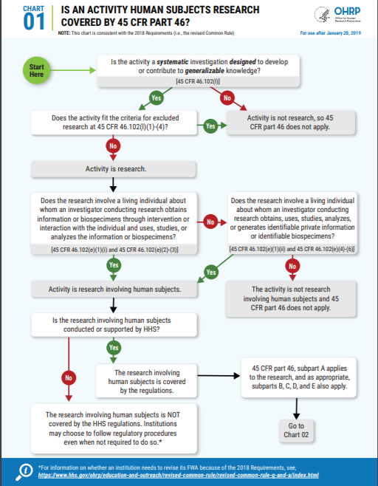
Human Subject Regulations Decision Charts
Visit the OHRP website to view graphic charts intended to aid those who need to decide if an activity is research involving human subjects that must be reviewed by an IRB!
Human Subject Regulations Decision Charts:
https://www.hhs.gov/ohrp/regulations-and-policy/decision-charts-2018/index.html

Slide 39
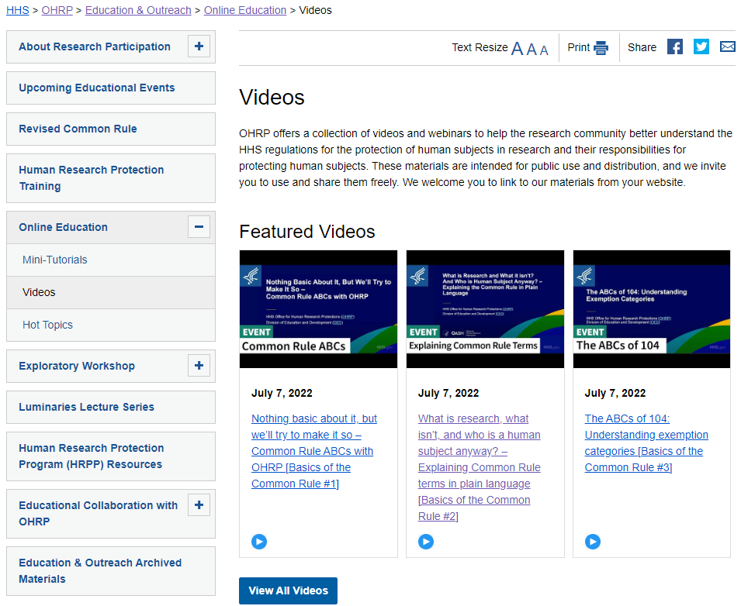
Online Education - Videos
For a deeper dive on these topics, check out our Featured Videos on the Basics of the Common Rule!
https://www.hhs.gov/ohrp/education-and-outreach/human-research-protection-training/index.html

Slide 40
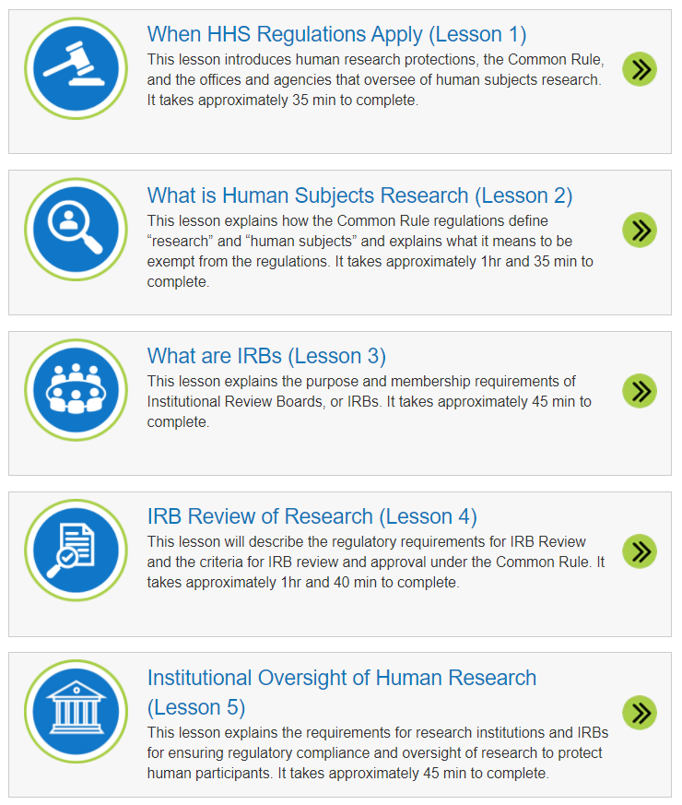
OHRP’s Human Research Protection Training
Free training
Satisfies the NIH requirements for training on human research protections for key personnel
Five self-study lessons with completion certificate after each lesson
Two interactive trainings on IRB review criteria considerations
Find it at OHRP website > Education & Outreach > Online Education
https://www.hhs.gov/ohrp/education-and-outreach/online-education/human-research-protection-training/index.html

Slide 41

Contacts and Resources
Contact us or submit your questions to OHRP@hhs.gov
Visit OHRP website at www.hhs.gov/ohrp, particularly the educational offerings under Education & Outreach
Check out OHRP’s About Research Participation informational resources for the public
http://www.hhs.gov/about-research-participation

Slide 42


Thank you!

